Slide 1



LAUNCHING
February 2023
Presented By
Otto Kroeger Associates (OKA)
BUILDING UPON DEEP
AND SHARED EXPERIENCE IN LEADERSHIP AND TEAM DEVELOPMENT, OKA HAS
CREATED THE WOMEN IN LEADERSHIP PROGRAM TO PROVIDE A PLATFORM
WHERE WOMEN CAN
LEARN FROM AND WITH ONE ANOTHER.
In this highly inclusive and interactive program, each participant will learn how
to develop her unique voice, navigate long-standing, traditional barriers, and build executive presence—all while exploring synergies and building a network which focuses on uplifting women in leadership.
WHO SHOULD ATTEND?
The Leadership Accelerator for Women (L.A.W.) program is designed for women who are anywhere from emerging leaders to senior level leaders with deeper experience. The curriculum is carefully
and deliberately designed to support-while- challenging leaders all along the experience continuum. And the program is excited to include leaders from corporations,
non-profits and government agencies.
Each Women in Leadership cohort will have opportunities to learn via focused training modules; facilitated discussions;
1-on-1 coaching; guest speakers; and real-life narratives from the field.

Slide 2

THE L. A. W. EXPERIENCE
The Leadership Accelerator for Women program provides a robust leadership development, coaching and networking experience through a combination of 10 valuable components.
1
Individual Leadership Profile (ILP): Define what success means to you as a leader. Learn tools and skills to create a roadmap for moving forward.
6
Community Building:
Connect and learn with others going
through similar experiences in their leadership journeys.
2
DRiV (Motives, Values, Behaviors) Assessment: Understand what
really drives you, what drains you, what are your values, and how you can best use these towards success as a leader.
7
Modules on Dynamic Topics:
Participate in and experience
informative workshops, building your executive Brand, influencing and negotiating, initiating difficult conversations, and fostering psychological safety—among others.
3
EQi (Emotional Intelligence)
360 Assessment: Gather feedback
from others on your strengths, development areas, and the behaviors you consistently put into the world.
8
Moving from Insight to Action:
Throughout the program create a targeted plan to help you narrow your focus on the leadership actions most pertinent for you.
4
(5) 60 minute Coaching Sessions: Develop the skills, confidence, resilience, and self-awareness you need to take your leadership to the next level.
9
Personal Board of Advisors:
As part of this program, you will have
a cohort that is OKA-organized and facilitated to support and guide your development around how to overcome barriers as a woman in leadership.
5
Guest Speakers: Soak in best practices and lessons learned
from leaders outside of your industry to get key take-aways to bring back to your organization.
10
Certification & Recognition:
Receive a Leadership Accelerator for Women Program Credly Badge to share with the world what you have learned and been a part of.

Slide 3



NEXT STEPS
If you are ready to be inspired, network with likeminded colleagues, and both learn and practice skills that will impact you, your career and your organization, we cannot wait to connect with you!
“Behind every successful woman is a tribe of other successful women who have her back. What we are committing to provide for each of our participants is
this tribe and community that helps turbo-charge their growth as a leader.”
Please contact the L.A.W. program
coordinator Jen Sanders at jsanders@oka-online.com, to register, or to schedule an exploratory discussion.
We look forward to welcoming you and your leaders to the L.A.W community.
Leadership Accelerator for Women
THE INVESTMENT
Your total investment for the Leadership Accelerator for Women Experience is $8,500

Slide 4

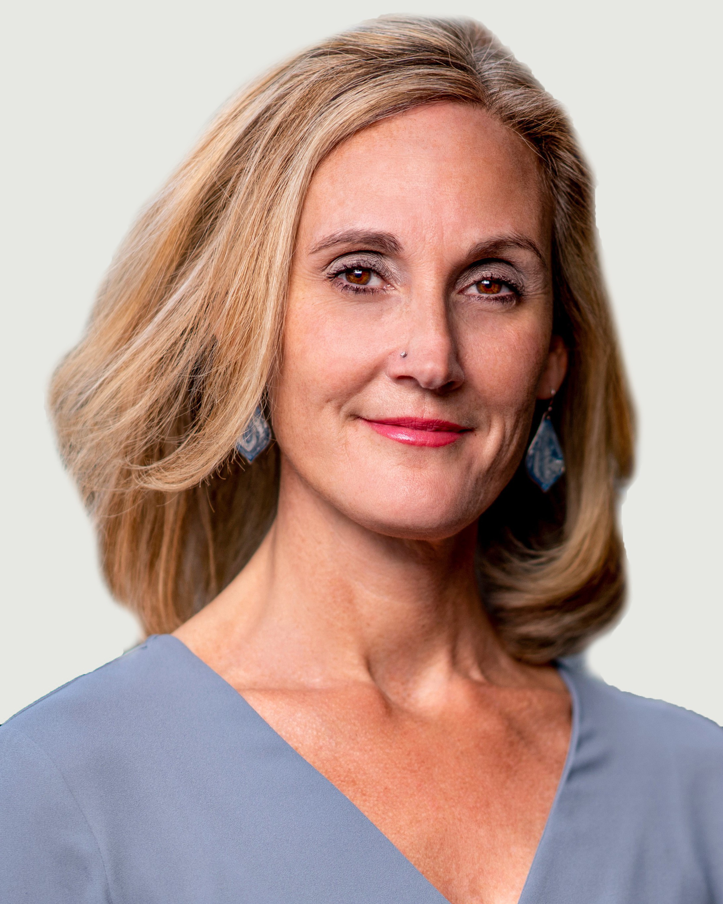




OUR PROGRAM DIRECTORS
The Leadership Accelerator for Women program is led by OKA consultants who bring deep senior leadership, coaching and development experience, along with a personal perspective on the unique leadership and career challenges facing women. OKA’s Leadership Accelerator for Women (L.A.W.) Program was co-created by and launched in partnership with Salima Hemani and SZH Consulting, LLC.
JEN SANDERS, MSOD, PCC | Senior Consultant, OKA
Jenifer Sanders is an experienced facilitator, organization development consultant, trainer and executive coach with deep knowledge of a range of psychological assessments and facilitative processes. With a Master’s Degree in Organization Development and extensive experience in adult education, Jen has led the development of OKA’s online and blended learning development programs, including certification courses and advanced application courses in report interpretation and team and organizational applications.
Jenifer is also a certified Master Practitioner in EQ-i® 2.0 and EQ360® emotional intelligence assessments, the DRiV, the Influence Style Indicator, the Change Style Indicator, and the Decision Style Profile,the Myers Briggs Type Indicator® (MBTI®), the Pearman Personality Integrator and other industry-leading tools.
REBECCA ONDREY | Consultant, OKA
A Lead Trainer with extensive experience in both group facilitation and executive leadership coaching, Rebecca brings a focused and accessible voice to training and discussions around diversity, inclusion, and the building and maintenance of safe, learning spaces. Her training and coaching are enhanced by her experiences as a teacher, an entrepreneur, and a program developer and manager in the non-profit sector. Rebecca has been a key contributor to OKA since 2015 and is a principal designer and facilitator of OKA’s Leadership Accelerator for Women (L.A.W.) program that launched in 2022.
STACY CAMPESI, PCC| Senior Consultant, OKA
Stacy has over 10 years of experience in executive coaching, leadership training, and organization development. Stacy has extensive experience leading strategy sessions, retreats, and workshops for senior executives and their teams. In addition, Stacy serves as an External Instructor for the George Washington University’s’ School of Business.
Stacy is a Professional Certified Coach (PCC) with the International Coach Federation. She is also a certified in using the in EQ-i® 2.0 and EQ360® emotional intelligence assessments and the Myers Briggs Type Indicator® (MBTI®). In addition, Stacy is certified as an Energy Leadership Master Practitioner® and Core Dynamics Leadership Specialist®.
VISIT OKA-ONLINE. COM TO LEARN MORE!

