Slide 1
Thank You for Thinking of OKA
We are excited about these new slides and our new workbook.
We hope you like them and they help enhance your EQ programs and coaching.
We hope to see you or hear from you soon.
Warmly,
The OKA team

Slide 2
OKA’s EQ-i Introduction Slides –Terms/Expectations of Use
OKA firmly believes that slides should serve and follow a good trainer or consultant, not the other way around. To this end, OKA presents these slides in PowerPoint (as opposed to a PDF format) to allow you to add slides of your own in addition to deleting any words/phrases with which you are not comfortable.
These materials are intended for use by those certified by OKA or those purchasing these materials separately.

Slide 3
OKA’s EQ-i Introduction Slides –Terms/Expectations of Use
These slides are for use in your own work and not to be further distributed.
These slides are designed and intended to be used with OKA’s EQ Workbook.
Since different PowerPoint versions and different aspect/display settings can disrupt the placement or positioning of certain graphics and animations, you are encouraged to review the slides in presentation mode before using them in any presentation—and make any needed formatting adjustments.

Slide 4
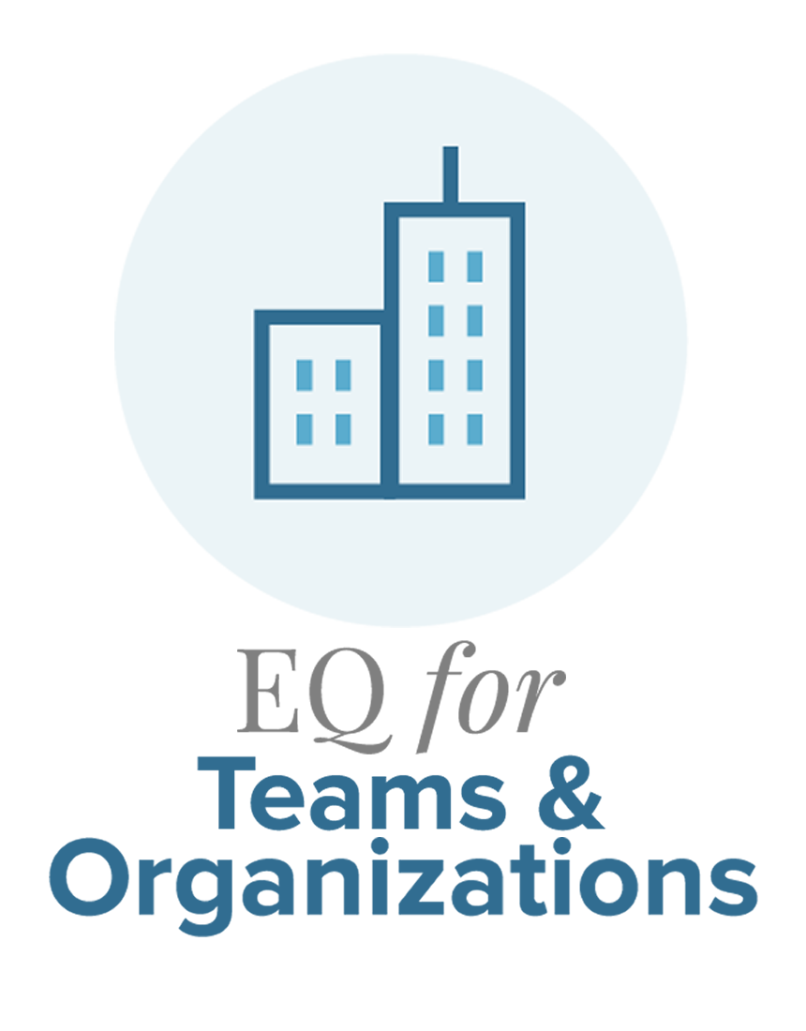
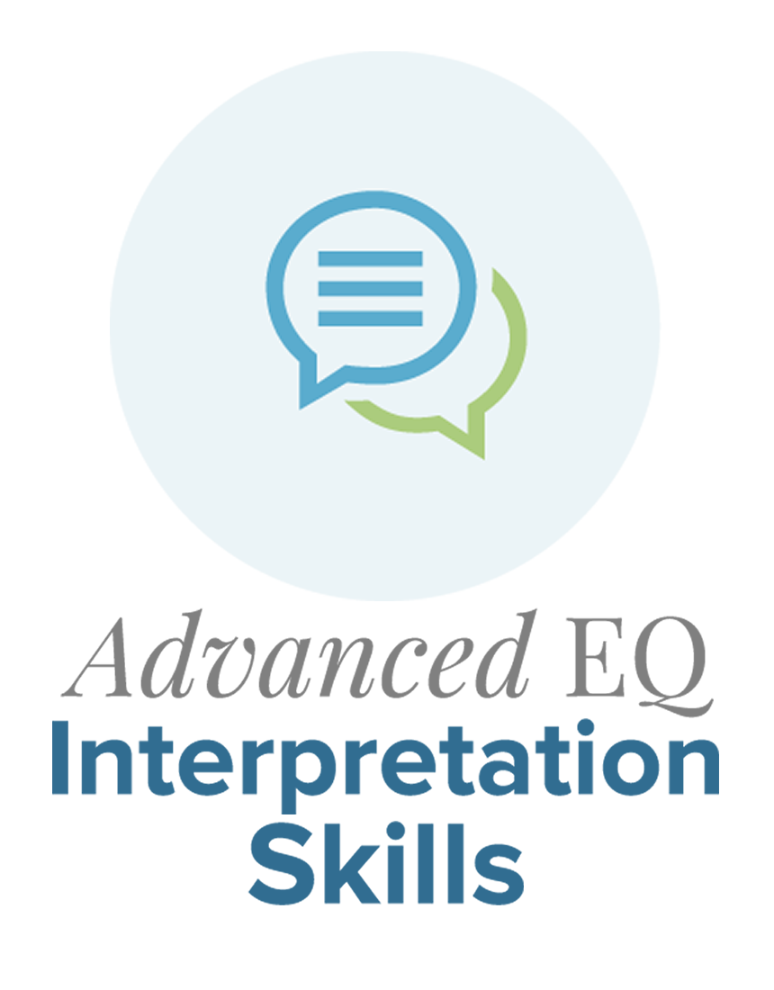
Additional OKA EQ Resources
Online
Offerings
Developing EQ (online)
Developing EQ
EQ 360 Programs
Online
Offerings
OKA’s
EQ Workbook

Slide 5
Additional OKA EQ Resources
Interested in more information about OKA programs or partnering with OKA?
Email Aaron at asanders@oka-online.com

Slide 6
EQ-i Introduction

Slide 7
Emotional Intelligence (EQ)
A collection of components comprising our emotional and social functioning and general psychological well-being
MHS’s EQ-i^{2.0} model is composed of 16 elements
Relates to potential for performance—not performance itself
Is comprised of elements that can change and be altered

Slide 8
What EQ is NOT
Cognitive Intelligence (IQ)
Skill Assessment
Achievement
Vocational Interest
Personal or Vocational Compatibility
Personality

Slide 9
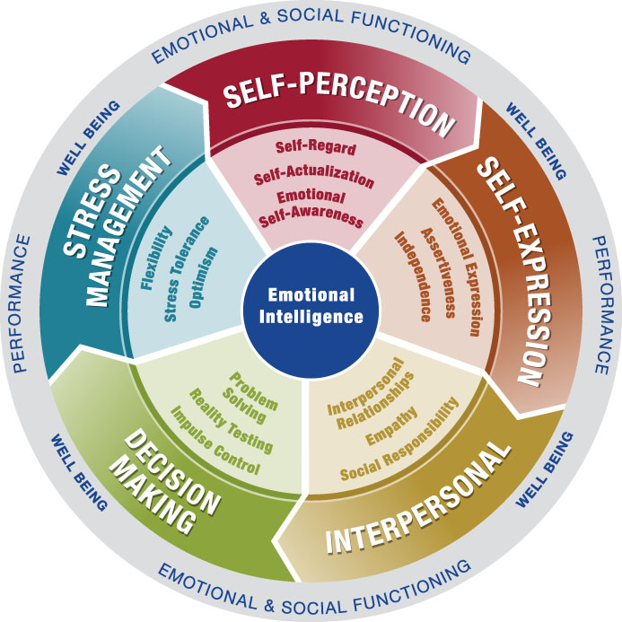
EQ-i^{2.0} Model

Slide 10
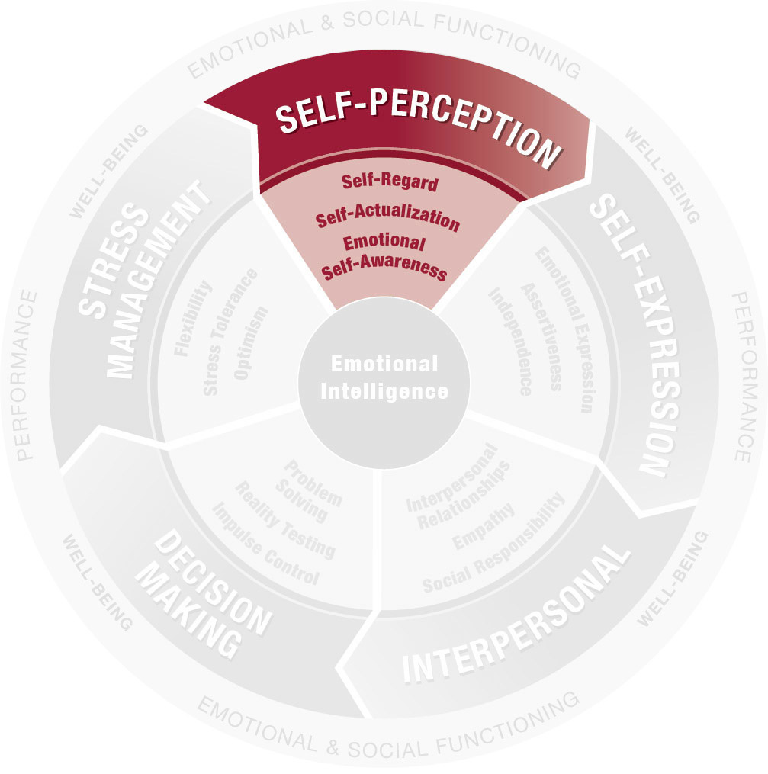
Self-Perception Composite
Self-Regard
Self-Actualization
Emotional Self-Awareness

Slide 11
Self-Regard
EQ Workbook Pg 6
the ability and the tendency for you— in full light of both your positive and negative qualities—to both like and have confidence in yourself

Slide 12
Self-Regard
EQ Workbook Pg 6
Low
Self-doubting & self-critical
Disrespecting of yourself
Insecure
Lacking self-esteem

Slide 13
Self-Regard
EQ Workbook Pg 6
Low
Average
Self-doubting & self-critical
Disrespecting of yourself
Insecure
Lacking self-esteem
Reasonable levels of self-confidence—pleased with some aspects of self, less of others

Slide 14
Self-Regard
EQ Workbook Pg 6
Low
Average
High
Self-doubting & self-critical
Disrespecting of yourself
Insecure
Lacking self-esteem
Reasonable levels of self-confidence—pleased with some aspects of self, less of others
Self-assurance, respect and acceptance, self-esteem and confidence—you like and are proud of who you are

Slide 15
Self-Regard
EQ Workbook Pg 6
Beware!
Too much Self-Regard can be or look/sound:
Self-assurance, respect and acceptance, self-esteem and confidence—you like and are proud of who you are
Arrogant
Vain & conceited
Narcissistic
Over-confident
Burdensome with thoughts of superiority

Slide 16
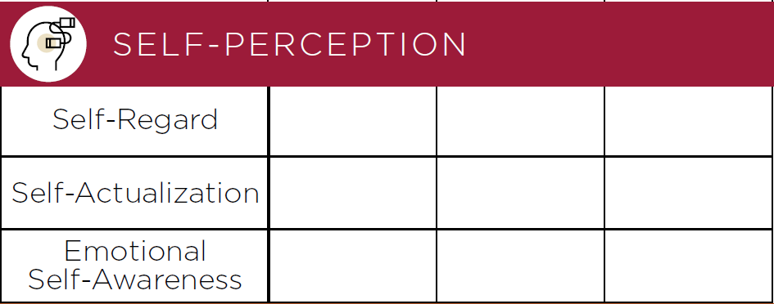
Self-Regard
EQ Workbook Front Flap
the ability and the tendency for you— in full light of both your positive and negative qualities—to both like and have confidence in yourself
Note your engagement level with Self-Regard on the front flap of your EQ Workbook

Slide 17
Self-Regard
EQ Workbook Pg 7
the ability and the tendency for you— in full light of both your positive and negative qualities—to both like and have confidence in yourself
What exercises, practices, or behaviors could activate and strengthen Self-Regard?

Slide 18
Self-Actualization
EQ Workbook Pg 8
your ability and tendency to want to grow, stretch and strive–to see your potential, set meaningful goals and work toward your betterment and fulfillment

Slide 19
Self-Actualization
EQ Workbook Pg 8
Low
Unambitious or underperforming
Lazy
Bored & uninspired
Ignorant—closed to learning and development

Slide 20
Self-Actualization
EQ Workbook Pg 8
Low
Average
Unambitious or underperforming
Lazy
Bored & uninspired
Ignorant—closed to learning and development
At times interested in and open to learning, advancement & development, but bored and complacent just as often

Slide 21
Self-Actualization
EQ Workbook Pg 8
Low
Average
High
Unambitious or underperforming
Lazy
Bored & uninspired
Ignorant—closed to learning and development
At times interested in and open to learning, advancement & development, but bored and complacent just as often
Healthy drive toward self-improvement and the pursuit of satisfaction through meaningful work and play

Slide 22
Self-Actualization
EQ Workbook Pg 8
Beware!
Too much Self-Actualization can be or look/sound:
Healthy drive toward self-improvement and the pursuit of satisfaction through meaningful work and play
Perpetually dissatisfied with the status quo
Overly goal-driven—too intense
Overly exuberant with your activities and points of passion
Self-centered—blind to the needs and interests of others

Slide 23
Self-Actualization
EQ Workbook Front Flap
your ability and tendency to want to grow, stretch and strive–to see your potential, set meaningful goals and work toward your betterment and fulfillment
Note your engagement level with Self-Actualization on the front flap of your EQ Workbook

Slide 24
Self-Actualization
EQ Workbook Pg 9
your ability and tendency to want to grow, stretch and strive–to see your potential, set meaningful goals and work toward your betterment and fulfillment
What exercises, practices, or behaviors could activate and strengthen Self-Actualization?

Slide 25
Emotional Self-Awareness
EQ Workbook Pg 10
the degree to which you are in touch with your feelings and emotions, are able to distinguish one emotion from another, and understand why that emotion has resulted

Slide 26
Emotional Self-Awareness
EQ Workbook Pg 10
Low
Emotionally unaware
Immature
Misunderstanding of others
Ignorant of your emotional needs and motivations

Slide 27
Emotional Self-Awareness
EQ Workbook Pg 10
Low
Average
Emotionally unaware
Immature
Misunderstanding of others
Ignorant of your emotional needs and motivations
When you pay attention, you generally know what you are feeling and why, but you don’t often take the time to consider your inner life

Slide 28
Emotional Self-Awareness
EQ Workbook Pg 10
Low
Average
High
Emotionally unaware
Immature
Misunderstanding of others
Ignorant of your emotional needs and motivations
When you pay attention, you generally know what you are feeling and why, but you don’t often take the time to consider your inner life
Understanding feelings, why you are feeling them, and an ability to differentiate one feeling from another

Slide 29
Emotional Self-Awareness
EQ Workbook Pg 10
Beware!
Too much Emotional Self-Awareness can be or look/sound:
Understanding feelings, why you are feeling them, and an ability to differentiate one feeling from another
Self-consumed—seeing things unrelated to you only through your own emotional filters
Self-centered and self-indulgent
Hypersensitive to your own emotions
Insensitive to others’ needs

Slide 30
Emotional Self-Awareness
EQ Workbook Front Flap
the degree to which you are in touch with your feelings and emotions, are able to distinguish one emotion from another, and understand why that emotion has resulted
Note your engagement level with Emotional Self-Awareness on the front flap of your EQ Workbook

Slide 31
Emotional Self-Awareness
EQ Workbook Pg 11
the degree to which you are in touch with your feelings and emotions, are able to distinguish one emotion from another, and understand why that emotion has resulted
What exercises, practices, or behaviors could activate and strengthen Emotional Self-Awareness?

Slide 32
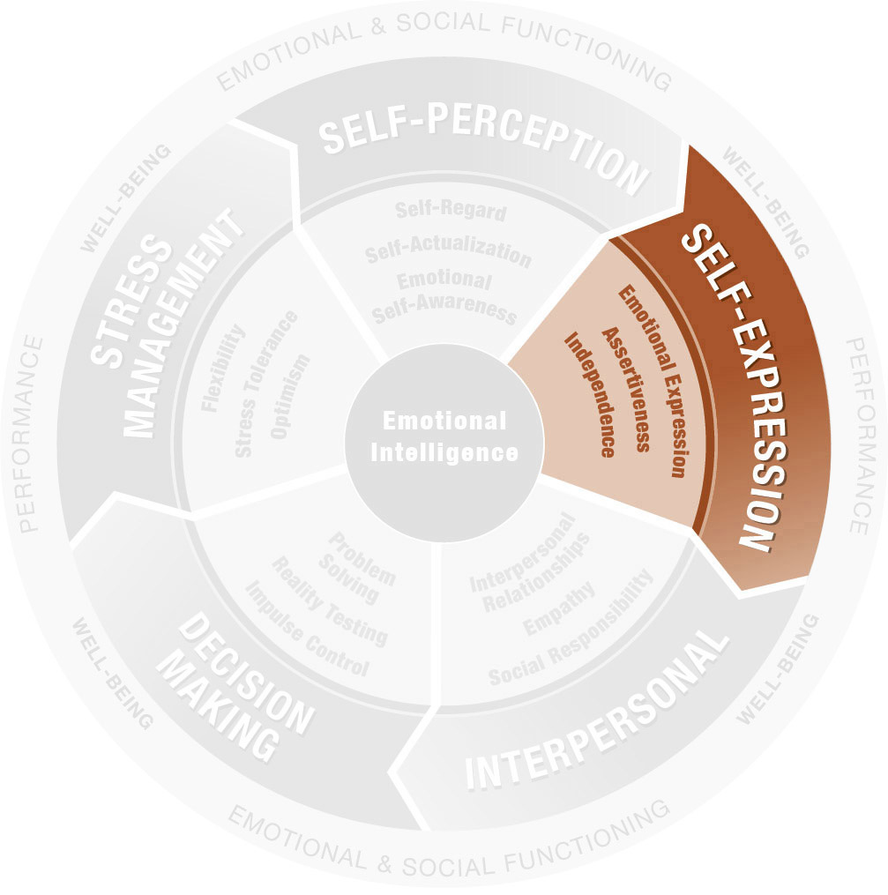
Self-Expression Composite
Emotional Expression
Assertiveness
Independence

Slide 33
Emotional Expression
EQ Workbook Pg 12
the degree to which you share, communicate and remain transparent with your feelings and emotions

Slide 34
Emotional Expression
EQ Workbook Pg 12
Low
Emotionally unaware/immature
Distrusting or isolated
Uncommunicative, detached and/or disconnected
In denial of your own feelings

Slide 35
Emotional Expression
EQ Workbook Pg 12
Low
Average
Emotionally unaware/immature
Distrusting or isolated
Uncommunicative, detached and/or disconnected
In denial of your own feelings
You are reasonably open & transparent—more in some circumstances and with some people than with others

Slide 36
Emotional Expression
EQ Workbook Pg 12
Low
Average
High
Emotionally unaware/immature
Distrusting or isolated
Uncommunicative, detached and/or disconnected
In denial of your own feelings
You are reasonably open & transparent—more in some circumstances and with some people than with others
A personal openness and a willingness and ability to share your emotions, making you authentic, transparent, and easy to read

Slide 37
Emotional Expression
EQ Workbook Pg 12
Too much Emotional Expression can be or look/sound:
Beware!
A personal openness and a willingness and ability to share your emotions, making you authentic, transparent, and easy to read
Injecting yourself or your emotional state into issues not related to you
Self-centered and self-indulgent
Overly transparent with a tendency to overshare
Emotionally hijacking

Slide 38
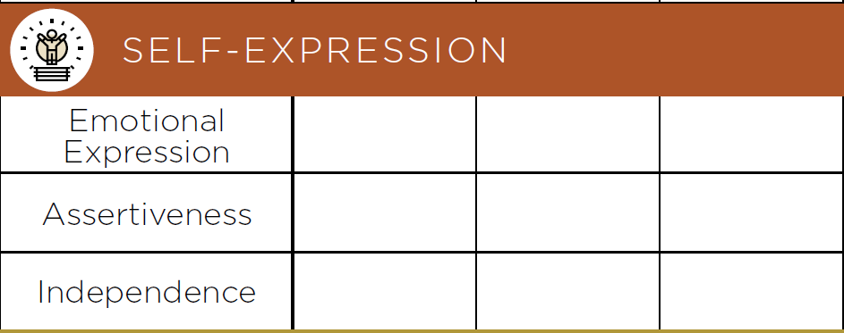
Emotional Expression
EQ Workbook Front Flap
the degree to which you share, communicate and remain transparent with your feelings and emotions
Note your engagement level with Emotional Expression on the front flap of your EQ Workbook

Slide 39
Emotional Expression
EQ Workbook Pg 13
the degree to which you share, communicate and remain transparent with your feelings and emotions
What exercises, practices, or behaviors could activate and strengthen Emotional Expression?

Slide 40
Assertiveness
EQ Workbook Pg 14
your ability to put your needs, thoughts and opinions out into the world—even when doing so invites opposition or conflict or causes you to take a stand

Slide 41
Assertiveness
EQ Workbook Pg 14
Low
Bashful, shy, or soft spoken
Withholding
Uncommitted to the cause or issue
Weak—easy to convince, sway, or take advantage of
Insubstantial

Slide 42
Assertiveness
EQ Workbook Pg 14
Low
Average
Bashful, shy, or soft spoken
Withholding
Uncommitted to the cause or issue
Weak—easy to convince, sway, or take advantage of
Insubstantial
Voice your needs and beliefs clearly and boldly some of the time or consistently stand up for yourself, but do so only mildly

Slide 43
Assertiveness
EQ Workbook Pg 14
Low
Average
High
Bashful, shy, or soft spoken
Withholding
Uncommitted to the cause or issue
Weak—easy to convince, sway, or take advantage of
Insubstantial
Voice your needs and beliefs clearly and boldly some of the time or consistently stand up for yourself, but do so only mildly
Straightforward, self-confident speech and behavior, speaking your mind and both setting and maintaining clear boundaries

Slide 44
Assertiveness
EQ Workbook Pg 14
Beware!
Too much Assertiveness can be or look/sound:
Straightforward, self-confident speech and behavior, speaking your mind and both setting and maintaining clear boundaries
Aggressive
Abusive
Militant or bossy
Self-centered (commanding the spotlight and excessive air-time)

Slide 45
Assertiveness
EQ Workbook Front Flap
your ability to put your needs, thoughts and opinions out into the world—even when doing so invites opposition or conflict or causes you to take a stand
Note your engagement level with Assertiveness on the front flap of your EQ Workbook

Slide 46
Assertiveness
EQ Workbook Pg 14
your ability to put your needs, thoughts and opinions out into the world—even when doing so invites opposition or conflict or causes you to take a stand
What exercises, practices, or behaviors could activate and strengthen Assertiveness?

Slide 47
Independence
EQ Workbook Pg 16
your ability and tendency to be self-directed in your thinking, feeling, and actions—to go it alone when needed

Slide 48
Independence
EQ Workbook Pg 16
Low
Emotionally dependent
Clingy
Intellectually lacking or weak-minded
Indecisive
Uninformed

Slide 49
Independence
EQ Workbook Pg 16
Low
Average
Emotionally dependent
Clingy
Intellectually lacking or weak-minded
Indecisive
Uninformed
Moderate or sporadic autonomy, suggesting someone who stands alone emotionally and intellectually as much as not

Slide 50
Independence
EQ Workbook Pg 16
Low
Average
High
Emotionally dependent
Clingy
Intellectually lacking or weak-minded
Indecisive
Uninformed
Moderate or sporadic autonomy, suggesting someone who stands alone emotionally and intellectually as much as not
Emotional and intellectual self-sufficiency and autonomy

Slide 51
Independence
EQ Workbook Pg 16
Beware!
Too much Independence can be or look/sound:
Emotional and intellectual self-sufficiency and autonomy
Emotionally withholding
Detached and un-collaborative
Isolated
Counter-dependent (you need authority to have something to push against)

Slide 52
Independence
EQ Workbook Front Flap
your ability and tendency to be self-directed in your thinking, feeling, and actions—to go it alone when needed
Note your engagement level with Independence on the front flap of your EQ Workbook

Slide 53
Independence
EQ Workbook Pg 17
your ability and tendency to be self-directed in your thinking, feeling, and actions—to go it alone when needed
What exercises, practices, or behaviors could activate and strengthen Independence?

Slide 54
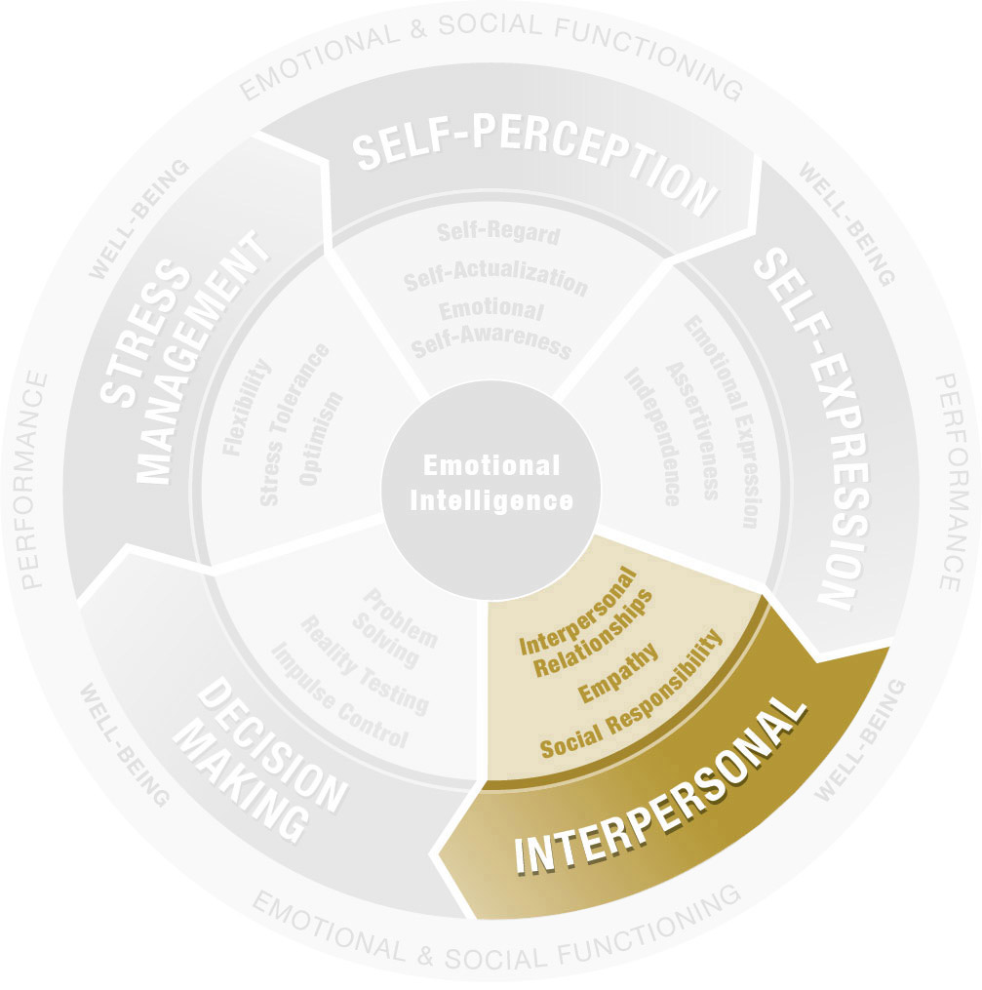
Interpersonal Composite
Interpersonal Relationships
Empathy
Social Responsibility

Slide 55
Interpersonal Relationships
EQ Workbook Pg 18
your ability and tendency to give and receive trust and compassion and to establish and maintain mutually satisfying personal relationships

Slide 56
Interpersonal Relationships
EQ Workbook Pg 18
Low
A loner
Socially withdrawn
Cold and unfriendly
Hard to like or get to know

Slide 57
Interpersonal Relationships
EQ Workbook Pg 18
Low
Average
A loner
Socially withdrawn
Cold and unfriendly
Hard to like or get to know
Yields at least a small circle of friends and family within which you are reasonably approachable, warm, and trusted

Slide 58
Interpersonal Relationships
EQ Workbook Pg 18
Low
Average
High
A loner
Socially withdrawn
Cold and unfriendly
Hard to like or get to know
Yields at least a small circle of friends and family within which you are reasonably approachable, warm, and trusted
An emphasis on connecting to others and being connected to by others—both giving and receiving trust, compassion and warmth

Slide 59
Interpersonal Relationships
EQ Workbook Pg 18
Too much Interpersonal Relationships can be or look/sound:
Beware!
An emphasis on connecting to others and being connected to by others—both giving and receiving trust, compassion and warmth
Inappropriately familiar or intimate
Too demanding or expectant of disclosure from others
Unable and unwilling to be alone
Co-dependent
Too free or disclosing with personal data

Slide 60
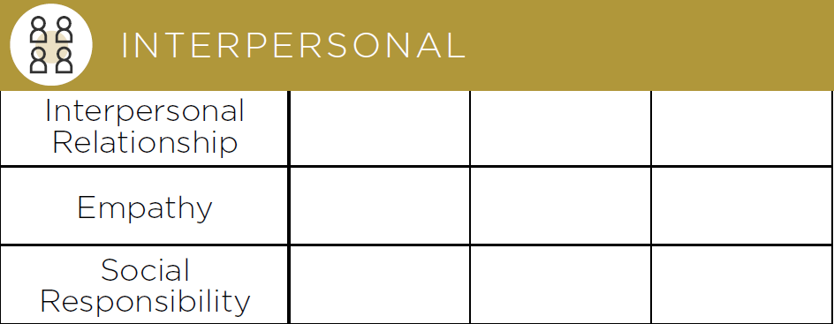
Interpersonal Relationships
EQ Workbook Front Flap
your ability and tendency to give and receive trust and compassion and to establish and maintain mutually satisfying personal relationships
Note your engagement level with Interpersonal Relationships on the front flap of your EQ Workbook

Slide 61
Interpersonal Relationships
EQ Workbook Pg 19
your ability and tendency to give and receive trust and compassion and to establish and maintain mutually satisfying personal relationships
What exercises, practices, or behaviors could activate and strengthen Interpersonal Relationships?

Slide 62
Empathy
EQ Workbook Pg 20
your ability and willingness to take notice of and be sensitive to other people’s needs and feelings

Slide 63
Empathy
EQ Workbook Pg 20
Low
Inattentive
Uncompassionate, unfeeling, or inhumane
Emotionally detached or distant
Selfish and self-centered

Slide 64
Empathy
EQ Workbook Pg 20
Low
Average
Inattentive
Uncompassionate, unfeeling, or inhumane
Emotionally detached or distant
Selfish and self-centered
Moderate or sporadic attention to others and/or you tend toward careful, focused attention, but only on certain people

Slide 65
Empathy
EQ Workbook Pg 20
Low
Average
High
Inattentive
Uncompassionate, unfeeling, or inhumane
Emotionally detached or distant
Selfish and self-centered
Moderate or sporadic attention to others and/or you tend toward careful, focused attention, but only on certain people
Aware of, concerned for, and sensitive to other people and their needs, resulting in both compassion and active listening

Slide 66
Empathy
EQ Workbook Pg 20
Too much Empathy can be or look/sound:
Beware!
Aware of, concerned for, and sensitive to other people and their needs, resulting in both compassion and active listening
Unable or unwilling to differentiate yourself and your emotional needs from others’
Dishonest—holding back the truth when it may hurt
Conflict avoidant
Emotionally dependent

Slide 67
Empathy
EQ Workbook Front Flap
your ability and willingness to take notice of and be sensitive to other people’s needs and feelings
Note your engagement level with Empathy on the front flap of your EQ Workbook

Slide 68
Empathy
EQ Workbook Pg 21
your ability and willingness to take notice of and be sensitive to other people’s needs and feelings
What exercises, practices, or behaviors could activate and strengthen Empathy?

Slide 69
Social Responsibility
EQ Workbook Pg 22
your ability and tendency to cooperate and contribute to the welfare of a larger social system, to have and act in accordance with a social consciousness and to show concern for the group or the greater community

Slide 70
Social Responsibility
EQ Workbook Pg 22
Low
Insensitive to others’ feelings or group needs
Socially and/or environmentally irresponsible
Selfish, paying little attention to community

Slide 71
Social Responsibility
EQ Workbook Pg 22
Low
Average
Insensitive to others’ feelings or group needs
Socially and/or environmentally irresponsible
Selfish, paying little attention to community
Moderate degree of thinking of and acting for the benefit of others or being motivated by the needs of only select people

Slide 72
Social Responsibility
EQ Workbook Pg 22
Low
Average
High
Insensitive to others’ feelings or group needs
Socially and/or environmentally irresponsible
Selfish, paying little attention to community
Moderate degree of thinking of and acting for the benefit of others or being motivated by the needs of only select people
Yields selflessness and a care and concern for people, the community, and the environment

Slide 73
Social Responsibility
EQ Workbook Pg 22
Beware!
Too much Social Responsibility can be or look/sound:
Yields selflessness and a care and concern for people, the community, and the environment
A martyr—consistently putting group needs before your own
Overly sensitive to others’ needs
Preachy and self-righteous—overly committed to social, community, or environmental causes

Slide 74
Social Responsibility
EQ Workbook Front Flap
your ability and tendency to cooperate and contribute to the welfare of a larger social system, to have and act in accordance with a social consciousness and to show concern for the group or the greater community
Note your engagement level with Social Responsibility on the front flap of your EQ Workbook

Slide 75
Social Responsibility
EQ Workbook Pg 23
your ability and tendency to cooperate and contribute to the welfare of a larger social system, to have and act in accordance with a social consciousness and to show concern for the group or the greater community
What exercises, practices, or behaviors could activate and strengthen Social Responsibility?

Slide 76
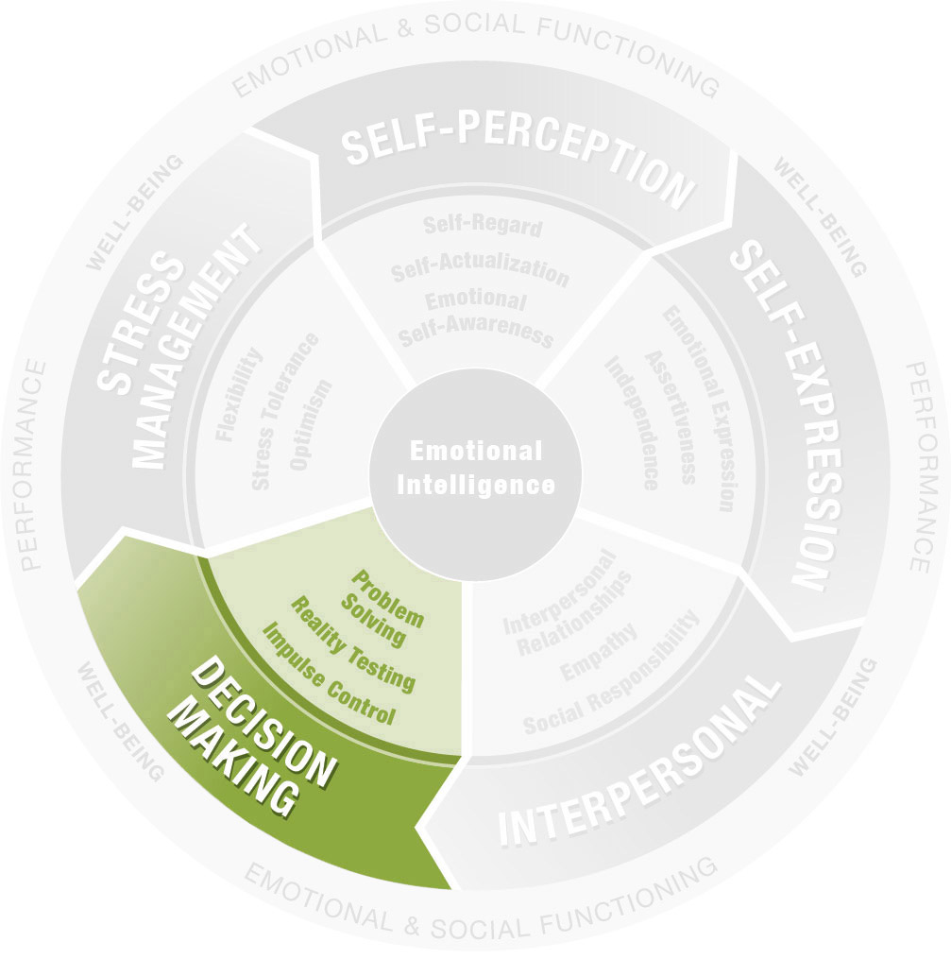
Decision Making Composite
Problem Solving
Reality Testing
Impulse Control

Slide 77
Problem Solving
EQ Workbook Pg 24
your ability and tendency both to solve problems that involve emotions and to use emotions as an effective problem-solving tool

Slide 78
Problem Solving
EQ Workbook Pg 24
Low
Conflict and problem avoidant
Emotionally ineffective
Unpredictable in problem solving
Unreliable
A weak and/or ineffective leader

Slide 79
Problem Solving
EQ Workbook Pg 24
Low
Average
Conflict and problem avoidant
Emotionally ineffective
Unpredictable in problem solving
Unreliable
A weak and/or ineffective leader
An often adequate, but not outstanding, tendency to engage the human and emotional side of conflict and problem solving

Slide 80
Problem Solving
EQ Workbook Pg 24
Low
Average
High
Conflict and problem avoidant
Emotionally ineffective
Unpredictable in problem solving
Unreliable
A weak and/or ineffective leader
An often adequate, but not outstanding, tendency to engage the human and emotional side of conflict and problem solving
You solve problems readily and well, even when you are upset or are engaged in upsetting situations

Slide 81
Problem Solving
EQ Workbook Pg 24
Beware!
Too much Problem Solving can be or look/sound:
You solve problems readily and well, even when you are upset or are engaged in upsetting situations
Engage problems too quickly, even when pause or reflection may be prudent
May well not engage conflict avoidance as a legitimate conflict approach, which at times it can be

Slide 82
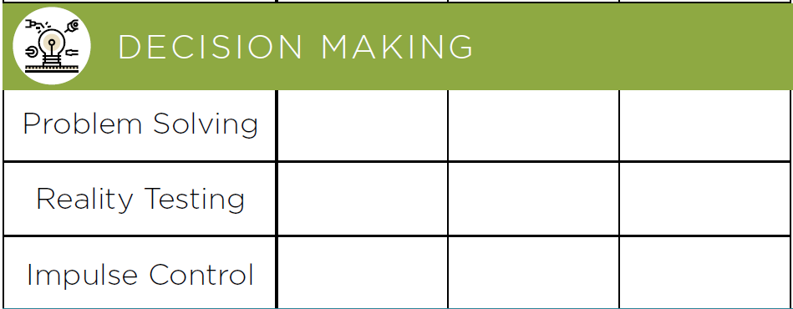
Problem Solving
EQ Workbook Front Flap
your ability and tendency both to solve problems that involve emotions and to use emotions as an effective problem-solving tool
Note your engagement level with Problem Solving on the front flap of your EQ Workbook

Slide 83
Problem Solving
EQ Workbook Pg 25
your ability and tendency both to solve problems that involve emotions and to use emotions as an effective problem-solving tool
What exercises, practices, or behaviors could activate and strengthen Problem Solving?

Slide 84
Reality Testing
EQ Workbook Pg 26
The ability and tendency for you to assess the here-and-now reality of any given moment or situation—what is actually going on—and compare that objectively to your fantasy of what is going on, thus avoiding being overcome by fantasies, daydreams and biases

Slide 85
Reality Testing
EQ Workbook Pg 26
Low
Unrealistic and overly dramatic
Impractical & untrustworthy
Dishonest—prone to exaggeration
Flighty and/or airheaded

Slide 86
Reality Testing
EQ Workbook Pg 26
Low
Average
Unrealistic and overly dramatic
Impractical & untrustworthy
Dishonest—prone to exaggeration
Flighty and/or airheaded
Ability to access objective, real facts to verify your emotional state, but it also suggests that this reality is not always consulted or considered

Slide 87
Reality Testing
EQ Workbook Pg 26
Low
Average
High
Unrealistic and overly dramatic
Impractical & untrustworthy
Dishonest—prone to exaggeration
Flighty and/or airheaded
Ability to access objective, real facts to verify your emotional state, but it also suggests that this reality is not always consulted or considered
You use the world as it actually exists as the basis for how you feel, making you routinely look/ sound practical & grounded

Slide 88
Reality Testing
EQ Workbook Pg 26
Beware!
Too much Reality Testing can be or look/sound:
You use the world as it actually exists as the basis for how you feel, making you routinely look/sound practical & grounded
Unable to trust or connect with elements of life outside of verifiable facts—including loyalty, love, esprit de corps, and/or spirituality
Unwilling/unable to connect with subjective, emotional elements of a situation

Slide 89
Reality Testing
EQ Workbook Front Flap
your ability and tendency both to solve problems that involve emotions and to use emotions as an effective problem-solving tool
Note your engagement level with Reality Testing on the front flap of your EQ Workbook

Slide 90
Reality Testing
EQ Workbook Pg 27
your ability and tendency both to solve problems that involve emotions and to use emotions as an effective problem-solving tool
What exercises, practices, or behaviors could activate and strengthen Reality Testing?

Slide 91
Impulse Control
EQ Workbook Pg 28
the ability to resist or delay a drive or temptation to do or say something or to decide too quickly or rashly

Slide 92
Impulse Control
EQ Workbook Pg 28
Low
Lacking in self-control
Impulsive
Explosive
Overly talkative —monopolizing conversations
Short fused, quick to anger

Slide 93
Impulse Control
EQ Workbook Pg 28
Low
Average
Lacking in self-control
Impulsive
Explosive
Overly talkative —monopolizing conversations
Short fused, quick to anger
An ability—not always engaged or exercised—to hold back, filter responses, and decide against an initial impulse to act or speak

Slide 94
Impulse Control
EQ Workbook Pg 28
Low
Average
High
Lacking in self-control
Impulsive
Explosive
Overly talkative —monopolizing conversations
Short fused, quick to anger
An ability—not always engaged or exercised—to hold back, filter responses, and decide against an initial impulse to act or speak
Effectively delay your impulses, which in turn allows for more carefully made and better decisions

Slide 95
Impulse Control
EQ Workbook Pg 28
Beware!
Too much Impulse Control can be or look/sound:
Effectively delay your impulses, which in turn allows for more carefully made and better decisions
Withdrawn or withholding in conversation
Overly structured or planned
Emotionally detached
Unexpressive

Slide 96
Impulse Control
EQ Workbook Front Flap
the ability to resist or delay a drive or temptation to do or say something or to decide too quickly or rashly
Note your engagement level with Impulse Control on the front flap of your EQ Workbook

Slide 97
Impulse Control
EQ Workbook Pg 29
your ability and tendency both to solve problems that involve emotions and to use emotions as an effective problem-solving tool
What exercises, practices, or behaviors could activate and strengthen Impulse Control?

Slide 98
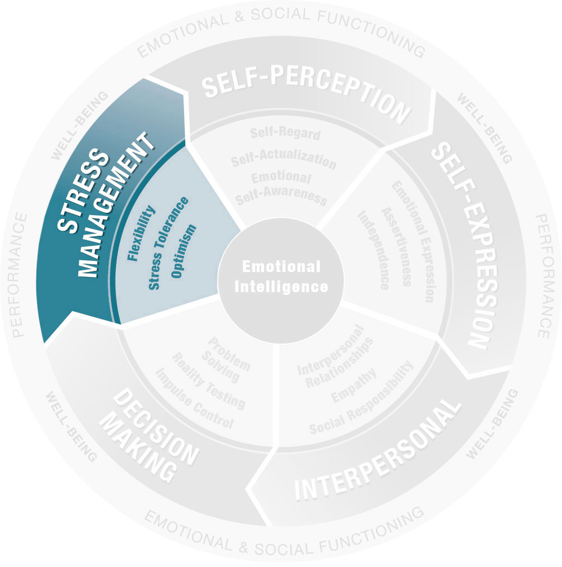
Stress Management Composite
Flexibility
Stress Tolerance
Optimism

Slide 99
Flexibility
EQ Workbook Pg 30
your ability and tendency to adjust your emotions, thoughts, and behavior to changing situations and conditions, to adapt—to take in new data and change your mind or approach

Slide 100
Flexibility
EQ Workbook Pg 30
Low
Rigid in your thinking
Set in your ways and opinions
Lacking curiosity
Change-resistant
Slow to start new project or efforts

Slide 101
Flexibility
EQ Workbook Pg 30
Low
Average
Rigid in your thinking
Set in your ways and opinions
Lacking curiosity
Change-resistant
Slow to start new project or efforts
As curious, open-minded, and adaptable as the average person—able to take in new data and change your mind, but often neglecting to do so

Slide 102
Flexibility
EQ Workbook Pg 30
Low
Average
High
Rigid in your thinking
Set in your ways and opinions
Lacking curiosity
Change-resistant
Slow to start new project or efforts
As curious, open-minded, and adaptable as the average person—able to take in new data and change your mind, but often neglecting to do so
Flex to new conditions and are open to change, bringing an open-minded curiosity and adaptability to most interactions

Slide 103
Flexibility
EQ Workbook Pg 30
Beware!
Too much Flexibility can be or look/sound:
Flex to new conditions and are open to change, bringing an open-minded curiosity and adaptability to most interactions
Prone to more starts than finishes
Reluctant to stick to a plan and come to closure
Easily bored with routine and predictability
Unwilling or unable to or keep commitments

Slide 104
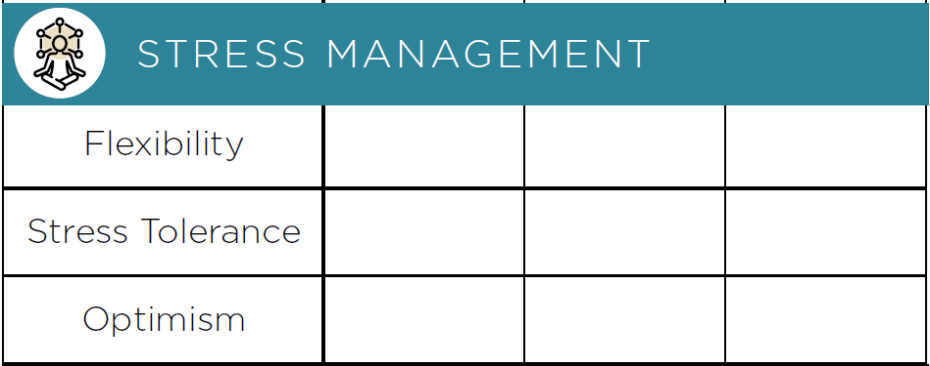
Flexibility
EQ Workbook Front Flap
your ability and tendency to adjust your emotions, thoughts, and behavior to changing situations and conditions, to adapt—to take in new data and change your mind or approach
Note your engagement level with Flexibility on the front flap of your EQ Workbook

Slide 105
Flexibility
EQ Workbook Pg 31
your ability and tendency to adjust your emotions, thoughts, and behavior to changing situations and conditions, to adapt—to take in new data and change your mind or approach
What exercises, practices, or behaviors could activate and strengthen Flexibility?

Slide 106
Stress Tolerance
EQ Workbook Pg 32
the ability to function well in the midst of challenging and stressful situations—to shoulder stress without getting overwhelmed

Slide 107
Stress Tolerance
EQ Workbook Pg 32
Low
Stressed, anxious or agitated
Procrastinating—delaying decisions due to fear or trepidation
Hopeless, giving up too quickly or easily

Slide 108
Stress Tolerance
EQ Workbook Pg 32
Low
Average
Stressed, anxious or agitated
Procrastinating—delaying decisions due to fear or trepidation
Hopeless, giving up too quickly or easily
Are able adequately to manage life’s stressors much of the time, sometimes letting fear or anxiety get the better of your efforts

Slide 109
Stress Tolerance
EQ Workbook Pg 32
Low
Average
High
Stressed, anxious or agitated
Procrastinating—delaying decisions due to fear or trepidation
Hopeless, giving up too quickly or easily
Are able adequately to manage life’s stressors much of the time, sometimes letting fear or anxiety get the better of your efforts
An effective array of tools and approaches to alleviate and shoulder stress and the self-confidence to solve problems

Slide 110
Stress Tolerance
EQ Workbook Pg 32
Beware!
Too much Stress Tolerance can be or look/sound:
An effective array of tools and approaches to alleviate and shoulder stress and the self-confidence to solve problems
Blind or ignorant to stressors and dangers that face you—you just don’t “get it”
Over-confident or conceited
Not invested in outcomes or consequences
Emotionally disconnected

Slide 111
Stress Tolerance
EQ Workbook Front Flap
the ability to function well in the midst of challenging and stressful situations—to shoulder stress without getting overwhelmed
Note your engagement level with Stress Tolerance on the front flap of your EQ Workbook

Slide 112
Stress Tolerance
EQ Workbook Pg 33
your ability and tendency to adjust your emotions, thoughts, and behavior to changing situations and conditions, to adapt—to take in new data and change your mind or approach
What exercises, practices, or behaviors could activate and strengthen Stress Tolerance?

Slide 113
Optimism
EQ Workbook Pg 34
your ability and tendency to look at the brighter side of life and to maintain a positive attitude even in the face of adversity. Optimism gives you hope and enables you to see the future as a positive, inviting place

Slide 114
Optimism
EQ Workbook Pg 34
Low
Helpless
Hopeless, prone to give up or give in too easily
Self-defeating or unmotivated
Negative and worried

Slide 115
Optimism
EQ Workbook Pg 34
Low
Average
Helpless
Hopeless, prone to give up or give in too easily
Self-defeating or unmotivated
Negative and worried
You are able to see positive possibilities in the future. However, while you can, at times you don’t, or the positive thoughts you have don’t last.

Slide 116
Optimism
EQ Workbook Pg 34
Low
Average
High
Helpless
Hopeless, prone to give up or give in too easily
Self-defeating or unmotivated
Negative and worried
You are able to see positive possibilities in the future. However, while you can, at times you don’t, or the positive thoughts you have don’t last.
Maintain a consistent positive attitude—even in adversity

Slide 117
Optimism
EQ Workbook Pg 34
Beware!
Too much Optimism can be or look/sound:
Maintain a consistent positive attitude—even in adversity
Blind to reality and danger
Prone to viewing bright sides and opportunities that do not actually exist
Known to let an unrealistic belief in a positive outcome take the place of effort

Slide 118
Optimism
EQ Workbook Front Flap
your ability and tendency to look at the brighter side of life and to maintain a positive attitude even in the face of adversity. Optimism gives you hope and enables you to see the future as a positive, inviting place
Note your engagement level with Optimism on the front flap of your EQ Workbook

Slide 119
Optimism
EQ Workbook Pg 35
your ability and tendency to look at the brighter side of life and to maintain a positive attitude even in the face of adversity. Optimism gives you hope and enables you to see the future as a positive, inviting place
What exercises, practices, or behaviors could activate and strengthen Optimism?

Slide 120
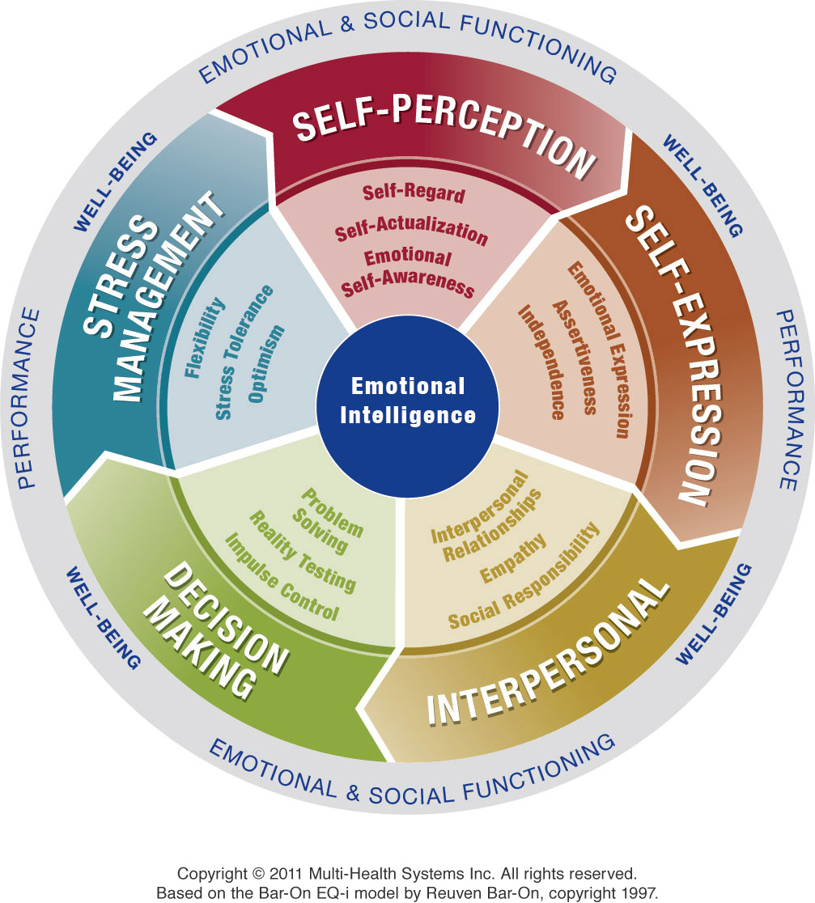
Happiness
Happiness

Slide 121
Happiness
EQ Workbook Pg 36
your ability and tendency to feel joy and satisfaction with the process of living—to be able to embrace all aspects of life with cheerfulness and enthusiasm

Slide 122
Happiness
EQ Workbook Pg 36
Low
Sad and depressed
Woeful or gloomy
Worried
Socially withdrawn
Unmotivated

Slide 123
Happiness
EQ Workbook Pg 36
Low
Average
Sad and depressed
Woeful or gloomy
Worried
Socially withdrawn
Unmotivated
Able to feel joy when life’s events and circumstances cooperate, but disappointments and struggles are likely seen as impediments to happiness

Slide 124
Happiness
EQ Workbook Pg 36
Low
Average
High
Sad and depressed
Woeful or gloomy
Worried
Socially withdrawn
Unmotivated
You are able to see positive possibilities in the future. However, while you can, at times you don’t, or the positive thoughts you have don’t last.
Routinely and consistently enjoying and deriving pleasure from life’s activities

Slide 125
Happiness
EQ Workbook Pg 36
Beware!
Too much Happiness can be or look/sound:
Routinely and consistently enjoying and deriving pleasure from life’s activities
Alienating to others with excessive cheer
Blind to pain and unhappiness
Refuse to connect with any task or person that does not contribute to your happiness and joy

Slide 126
Happiness
EQ Workbook Front Flap
your ability and tendency to feel joy and satisfaction with the process of living—to be able to embrace all aspects of life with cheerfulness and enthusiasm
Note your engagement level with Happiness on the front flap of your EQ Workbook

Slide 127
EQ-i^{2.0} Model

Slide 128
Interpreting Scores
Unlike other trait-based instruments, EQ-i scores do NOT necessarily reflect skill or lack thereof
The results reflect a self-assessment of the degree to which each EQ element is active and or important in your life and some associated behaviors
Results of the EQ-i are an Impressionist painting in need of interpretation, not a photograph rendering a verdict

Slide 129
EQ-i North American Norm Group
Age Group | Male | Female | Total
18-24 | 200 | 200 | 400
25-29 | 200 | 200 | 400
30-34 | 200 | 200 | 400
35-39 | 200 | 200 | 400
40-44 | 200 | 200 | 400
45-49 | 200 | 200 | 400
50-54 | 200 | 200 | 400
55-59 | 200 | 200 | 400
60-64 | 200 | 200 | 400
65+ | 200 | 200 | 400
Total | 2,000 | 2,000 | 4,000
N = 4,000
Within 4% of Census
Race/ethnicity
Geographic region
Education level
 | EQ-I | EQ-i^{2.0} | Census
White | 79.0% | 70.0% | 66.0%
African American | 7.1% | 11.4% | 12.3%
Hispanic | 2.8% | 12.0% | 15.1%
Asian/Other | 11.1% | 6.6% | 6.6%

Slide 130
Low Scores
A score under 90 means you answered the questions reflecting less connection or attraction to the behaviors of that particular EQ element than about three-quarters of the population or norm group
Low scores could reflect low skill and behavioral development in that area
Low scores could also mean a general discounting of the element in importance OR an extreme selectivity in the exercising of this behavior or EQ element

Slide 131
Moderate Scores
A score between 90 and 110 (100 is the mean score) indicates you answered the questions with the same intensity and frequency that most people did
Remember that moderate scores could reflect moderate or average skill and behavioral development in that area
Moderate scores can also mean effective use of the EQ element with a targeted group or inner-circle of people

Slide 132
High Scores
A score over 110 means you answered the questions reflecting more connection to or engagement with that particular EQ element than about three-quarters of the population or norm group.
High scores could reflect skill and behavioral development
High scores could also mean an overly developed, overdone or intense utilization of that EQ element

Slide 133
Interpreting Your EQ-i Report
After having done a self-assessment on each of the EQ scales, read over your EQ-i report.
Determine which of your scores are low (under 90), moderate (90 to 110) and high (over 110).
Which of these do not match your self-assessment?

Slide 134
EQ-i^{2.0} Model

