Slide 1
The Loving Challenger
Barb Heenan, PCC, CPC, ELI-MP
© 2019 Barb Heenan

Slide 2
What is your definition of “a Challenger”?
© 2019 Barb Heenan

Slide 3
What is our job as coaches?
Help them feel better? Help them fix their problem?
NO
© 2019 Barb Heenan

Slide 4
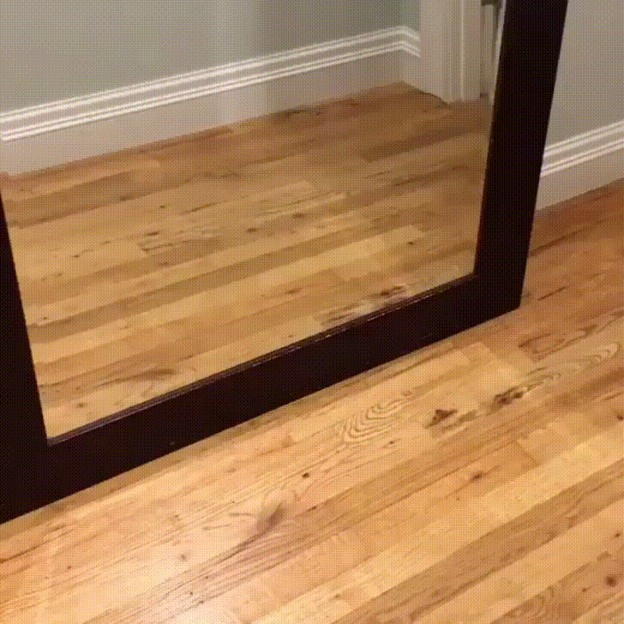
Our job is to:
Be the mirror that helps them see themselves
© 2019 Barb Heenan

Slide 5
When we challenge our clients, what are we actually doing?
Holding them to their greatest potential
© 2019 Barb Heenan

Slide 6
A challenger is:
A catalyst for learning, change, and/or growth
© 2019 Barb Heenan

Slide 7
The master skill of the challenger is to:
Provide loving pressure in the face of discomfort
(including our own)
© 2019 Barb Heenan

Slide 8
Exercise:
Mad Libs!
Breakout in twos, fill out your Mad Libs separately (1-2 mins)
Coaching, 5 mins each
Tasks for the coach:
Listen for the emotions; Affirm the emotions
Use your curiosity in service of growth
Practice presence (let go of the perfect, brilliant question!)
Goal here: heighten their awareness, not ”fix their issue”
© 2019 Barb Heenan

Slide 9
Exercise: Mad Libs!
1. What I’m most concerned about when challenging a client is: ___________________
2. If I challenge a client, “I’ll be seen as: ___________ and I’ll lose:________________
3. If I challenge a client, what I’m most afraid of, is that they will:
___________________________________________________________
4. “Sometimes I don’t like big emotions, intensity, conflict, and/or challenging the client because
__________________________________________
© 2019 Barb Heenan

Slide 10
Why is this important?
Challenging helps the client:
Create alignment
Clarify desires (and motivate action)
Let go of what no longer serves them
Take responsibility (put them back in their personal power)
© 2019 Barb Heenan

Slide 11
Why is this important?
Not challenging the client means that:
The limit of your discomfort may contribute to the limit of your client’s growth
© 2019 Barb Heenan

Slide 12
When might we use the skill of challenging?
Incongruence with a goal or value
Repeat pattern of thoughts, emotions or behavior
They are in resistance to something
© 2019 Barb Heenan

Slide 13
What is the challenge for coaches?
Self-awareness….
© 2019 Barb Heenan

Slide 14
What is the challenge for coaches?
Missing the opportunity, due to:
Worrying about the next brilliant question
Trying to fix or solve their issue
Not listening for the emotions underneath
Holding on to the belief that the client needs your knowledge
© 2019 Barb Heenan

Slide 15
What is the challenge for coaches?
Detaching from their story, or your personal beliefs
Your definition of success prevents you from challenging…
The HOW
Uncertainty about the outcome
Stuck in your own head (vs. heart)
© 2019 Barb Heenan

Slide 16
What is the challenge for coaches?
“I have to help them find relief from their pain!”
© 2019 Barb Heenan

Slide 17
HOW do we challenge the client?
The Prep Work:
Face discomfort with ________
Get comfortable with ________
Let go of being liked and being the _ _ _ _
PRESENCE
EMOTIONS
H
E
R
O
© 2019 Barb Heenan

Slide 18
HOW do we challenge the client?
The Prep Work:
Emotions are just:
ENERGY
MOTION
__________ in ____________
© 2019 Barb Heenan

Slide 19
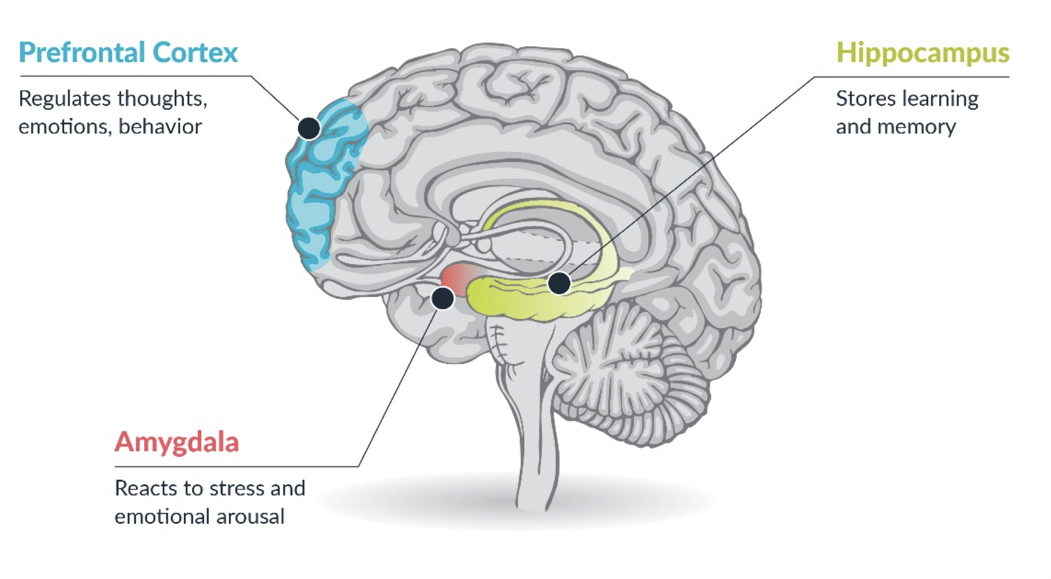
X
© 2019 Barb Heenan

Slide 20
Exercise:
“Shake It Up”
© 2019 Barb Heenan

Slide 21
HOW do we challenge the client?
Listen deeply
Affirm their feelings
Have some phrases ready
Utilize empowering questions
© 2019 Barb Heenan

Slide 22
We can set an intention to listen for:
Emotions
Head vs. Heart
What’s going well
Where they are stuck
What strengths are showing up
When something isn’t aligning
© 2019 Barb Heenan

Slide 23
Affirmation of Emotions
Given the fact that (SITUATION),
It makes perfect sense you would feel (EMOTIONS).
It’s perfectly normal for you because you value (INSERT VALUE)
© 2019 Barb Heenan

Slide 24
Phrases at the Ready:
“Something’s not aligning here…”
“It feels like Resistance has shown up in the room…”
“I’d like to challenge you for a moment.”
© 2019 Barb Heenan

Slide 25
Powerful Questions for Challenging the Client: (From Conscious Leaders Group)
“How willing are you to take 100% responsibility for this issue?”
“How willing are you to feel all your feelings about this issue?
“What’s a completely unenlightened way to look at this issue?”
© 2019 Barb Heenan

Slide 26
Powerful Questions for Challenging the Client: (From Conscious Leaders Group)
“What are you not facing re: this issue?”
“What is the hardest thing to accept about this issue?
“What do you really want?”
“What is an easy, measurable way to take action on this?”
© 2019 Barb Heenan

Slide 27
Exercise:
Coaching
Breakout in twos; Coaching - 5 mins each
Partner 1: (Client) Discuss a goal you’re struggling with or repeat pattern of thoughts, emotions, behavior that you want to change
Partner 2 (Coach): Coach your client to see what’s misaligned
Tasks:
Be present with the client
Listen for the emotions and affirm them
Ask them Challenger questions
Goal here: Feel the discomfort and stay with it
© 2019 Barb Heenan

Slide 28
A commitment
Tasks:
Discuss your commitment
Create an Action Plan
Hold each other accountable (exchange numbers and set a date to follow up)
Goal here: Commit to your growth as a coach
© 2019 Barb Heenan

Slide 29
REMEMBER:
RESIST the urge to:
Avoid the uncomfortable
Get caught in their story
Mentor from your own experience
Fix their issue
Be the Expert
© 2019 Barb Heenan

Slide 30
The Loving Challenger
Barb Heenan, PCC, CPC, ELI-MP
© 2019 Barb Heenan

